Slide 1
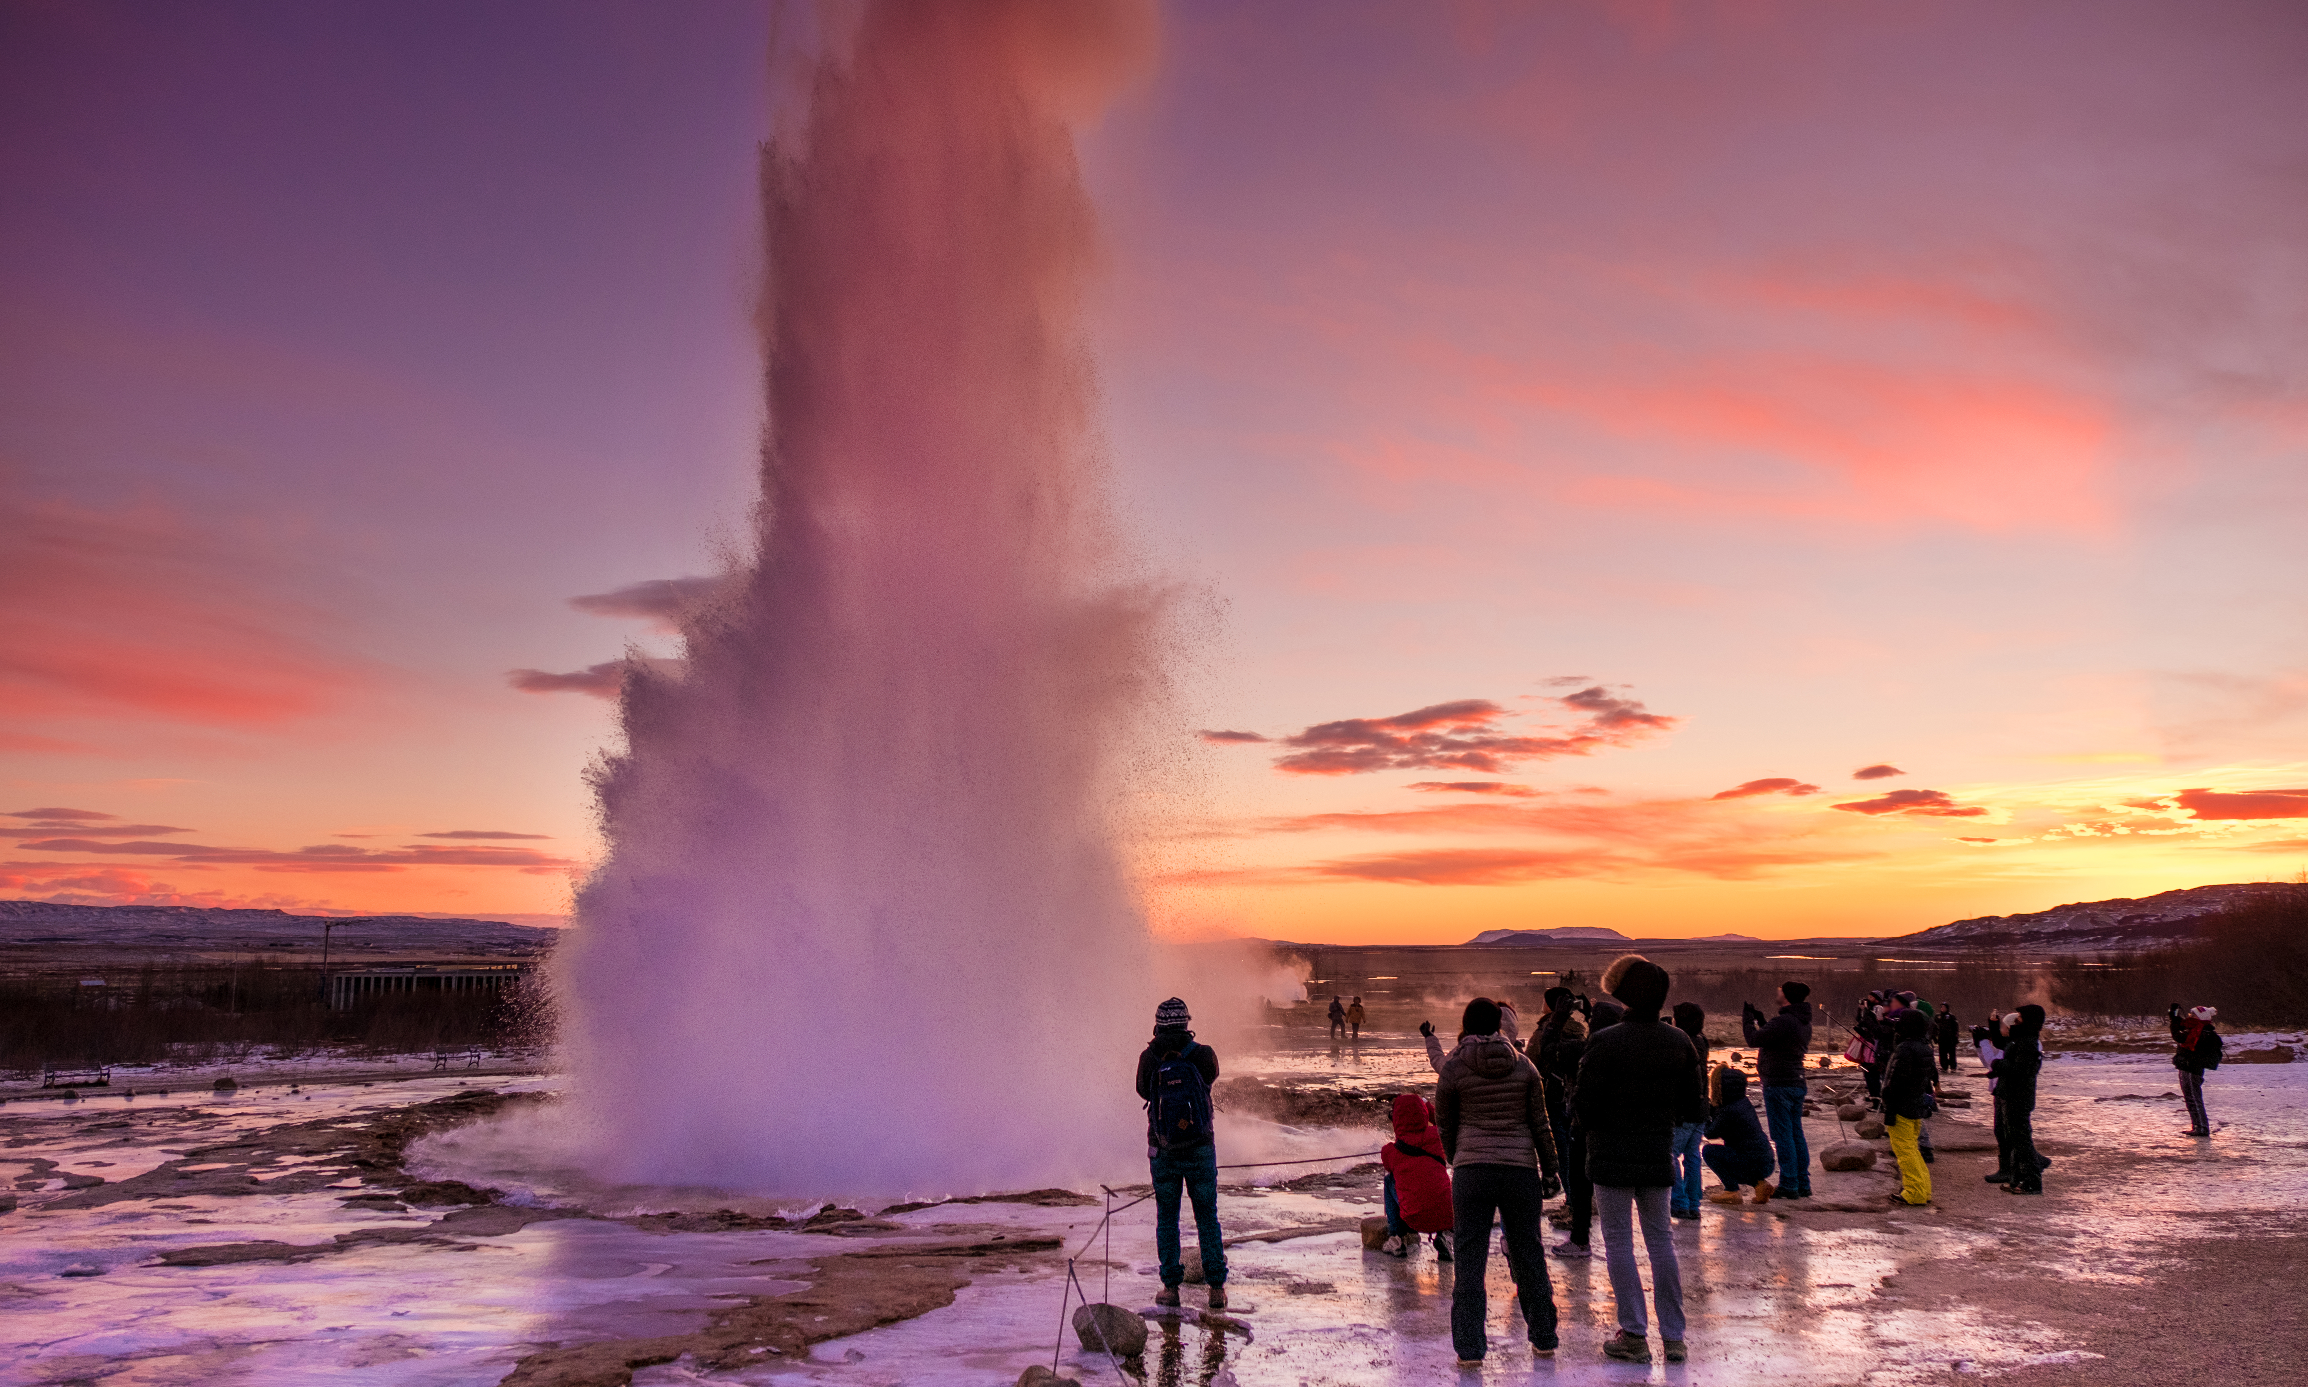

THE CHALLENGE OF NATURAL HAZARDS
Tectonics and Resources - Geysers
Describe the two types of geysers.
Fountain geysers erupt from pools of water, typically violent bursts of water and steam.
Cone geysers erupt from cones or mounds of siliceous sinter, these normally have steady jets that last a few seconds to several minutes.
What is a geyser?
A geyser is a hot spring that spouts jets of steam and hot water into the air. The term geyser comes from the Icelandic word geysir, meaning ‘to gush’.
What is a magma plume?
A mantle plume is an upwelling of hot rock within the Earth's mantle. The mantle plume in Iceland is approximately 2,880 km in depth. The heat from the plume causes rocks in the lower lithosphere to melt.
Draw a labelled field sketch of a geyser.
How are geysers created?
Geysers are made from holes in the Earth's surface that runs deep into the crust. The hole fills with water. At the bottom of the hole is molten rock which heats the water in the hole and sends the jets of steam toward the surface, shooting out of the ground.
Identify the possible negative impacts of tourism visiting the geothermal park.
Footpath erosion
Litter, air and noise pollution
Conflict with locals
Increase traffic and congestion
How does geothermal energy work in Iceland?
Geothermal water is used to heat around 90% of Iceland's homes. Hot water from the springs is cooled and pumped straight into the taps of nearby homes, stopping the need for hot water heating. The steam from the hot springs rotate turbines that activates a generator, which produces electricity.
Identify the possible positive impacts of tourism visiting the geothermal park.
Jobs, Education, Knowledge
Investment in infrastructure
Multiplier effect
Investment from TNCs

