Slide 1
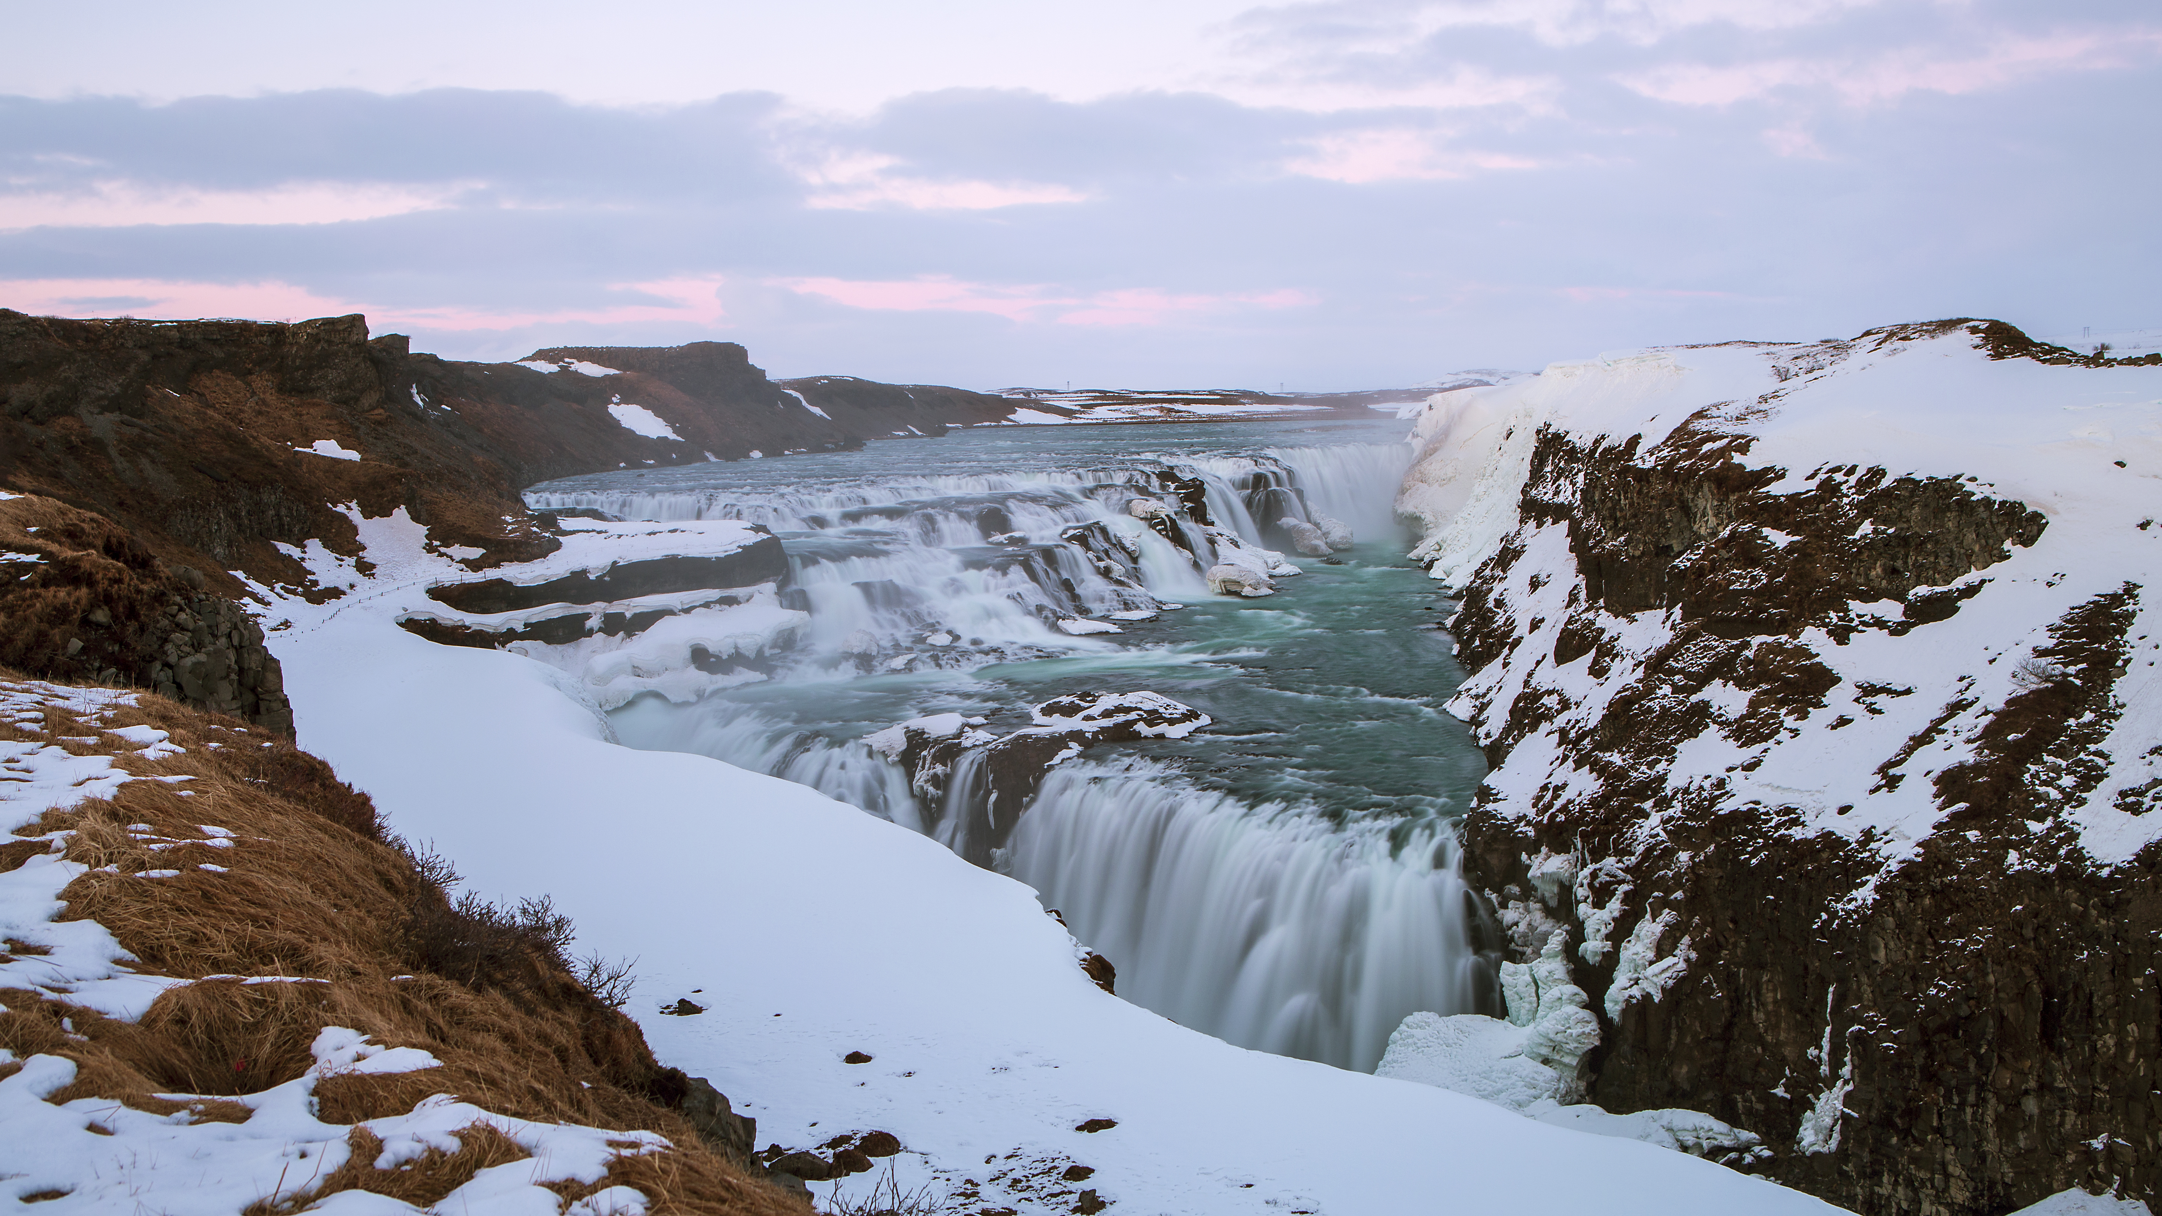

PHYSICAL LANDSCAPES RIVERS
Gullfoss
Name four types of river transportation.
Describe the location of Gullfoss waterfall.
Facts about Gullfoss waterfall.
Name four types of river erosion.
Suggest one reason why a river would drop its load.
Draw a field sketch of Gullfoss waterfall.
Explain the formation of a waterfall.
Explain the formation of a meander.

