Slide 1
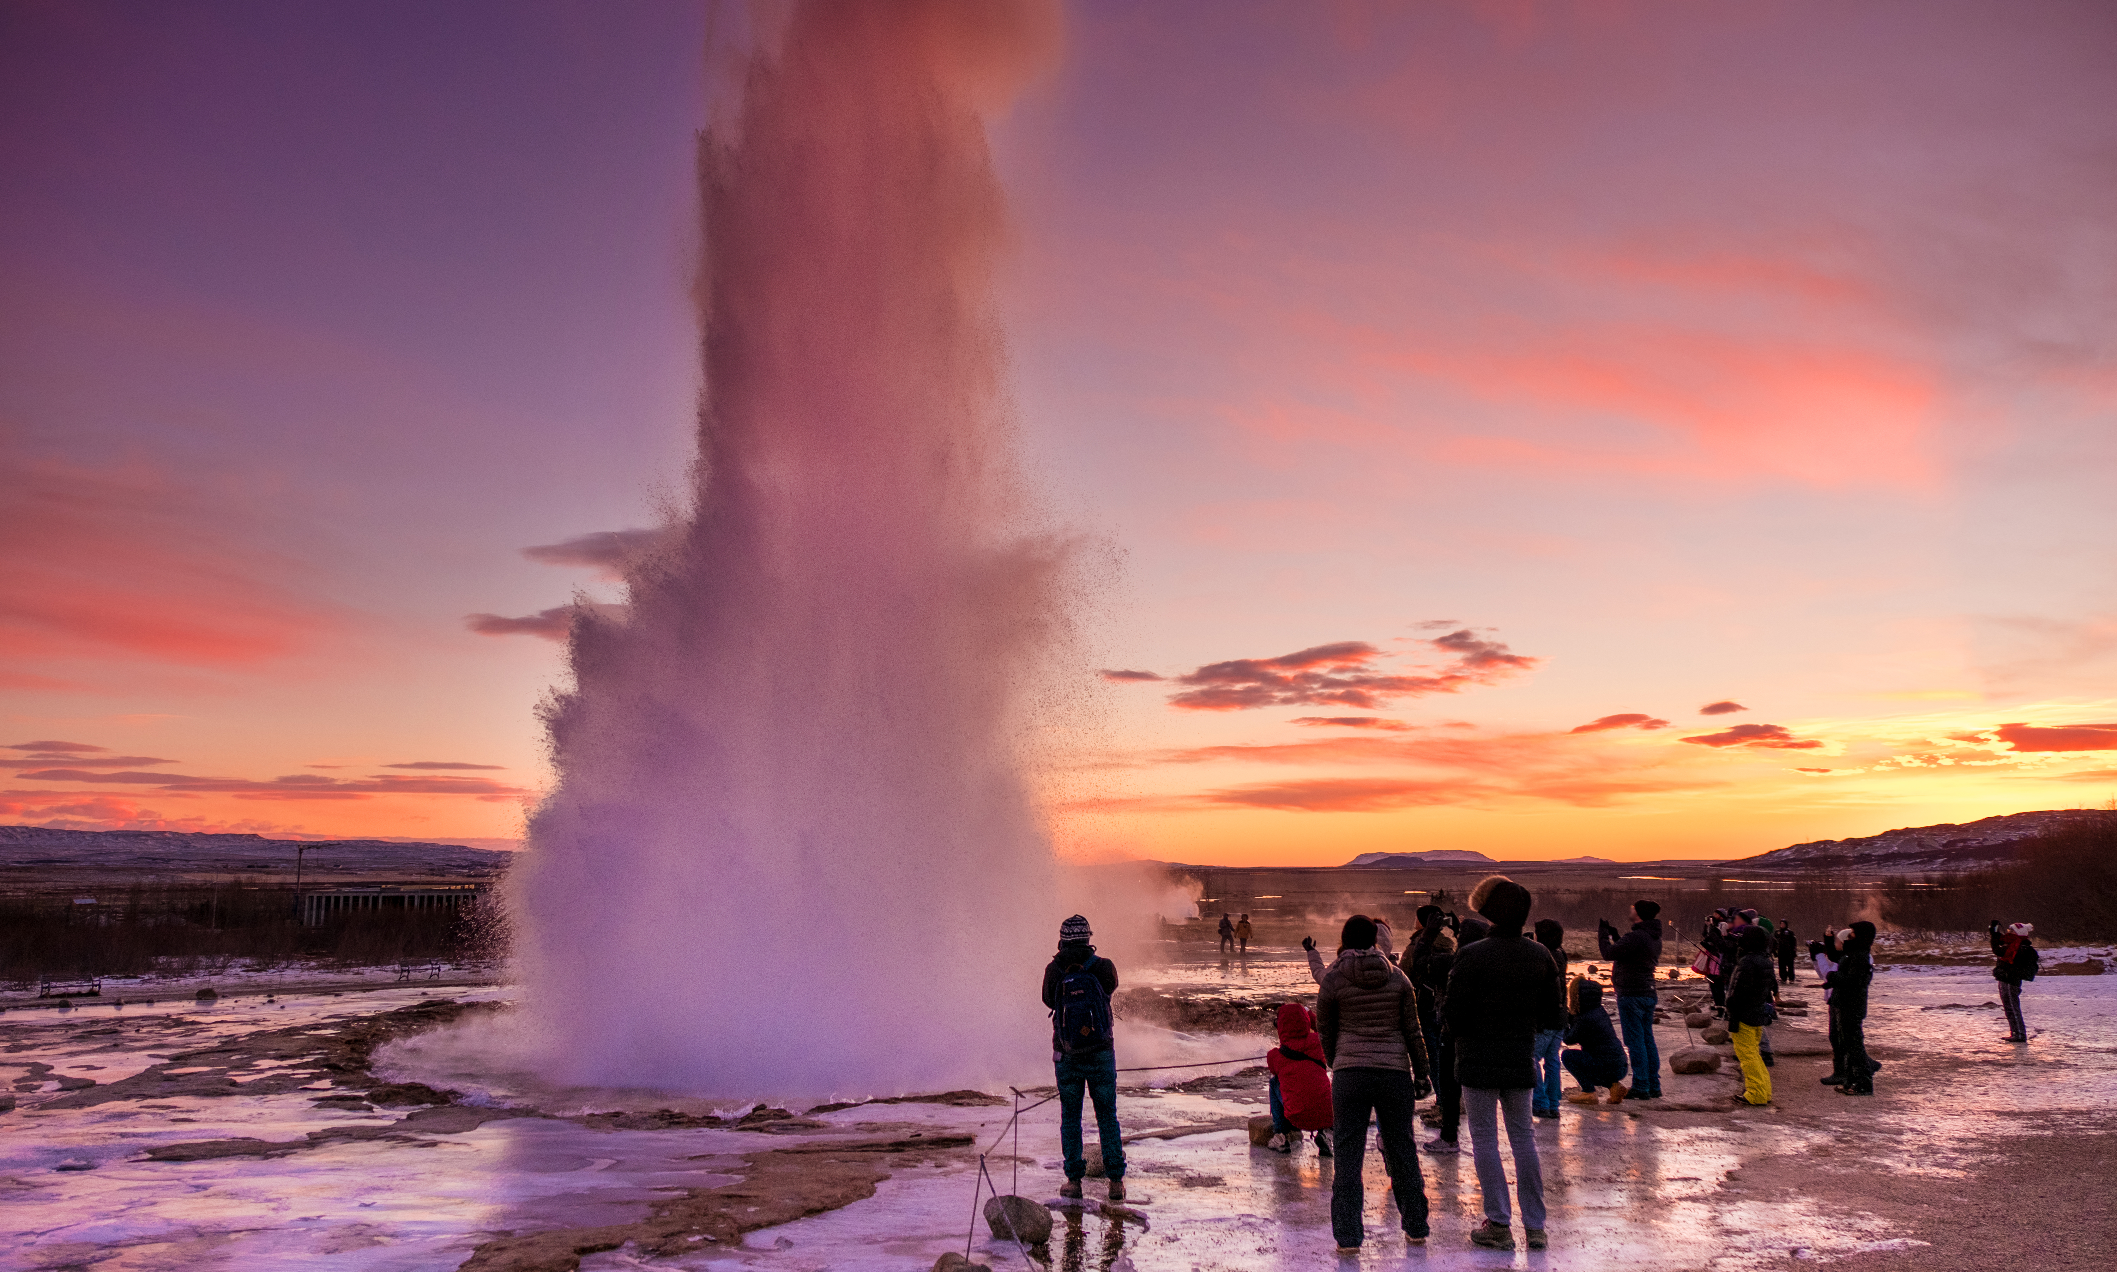

THE CHALLENGE OF NATURAL HAZARDS
Tectonics and Resources - Geysers
Describe the two types of geysers.
What is a geyser?
What is a magma plume?
Draw a labelled field sketch of a geyser.
How are geysers created?
Identify the possible negative impacts of tourism visiting the geothermal park.
How does geothermal energy work in Iceland?
Identify the possible positive impacts of tourism visiting the geothermal park.

